Slide 1
Audio Examples
Submitted to ICASSP 2025

Slide 2
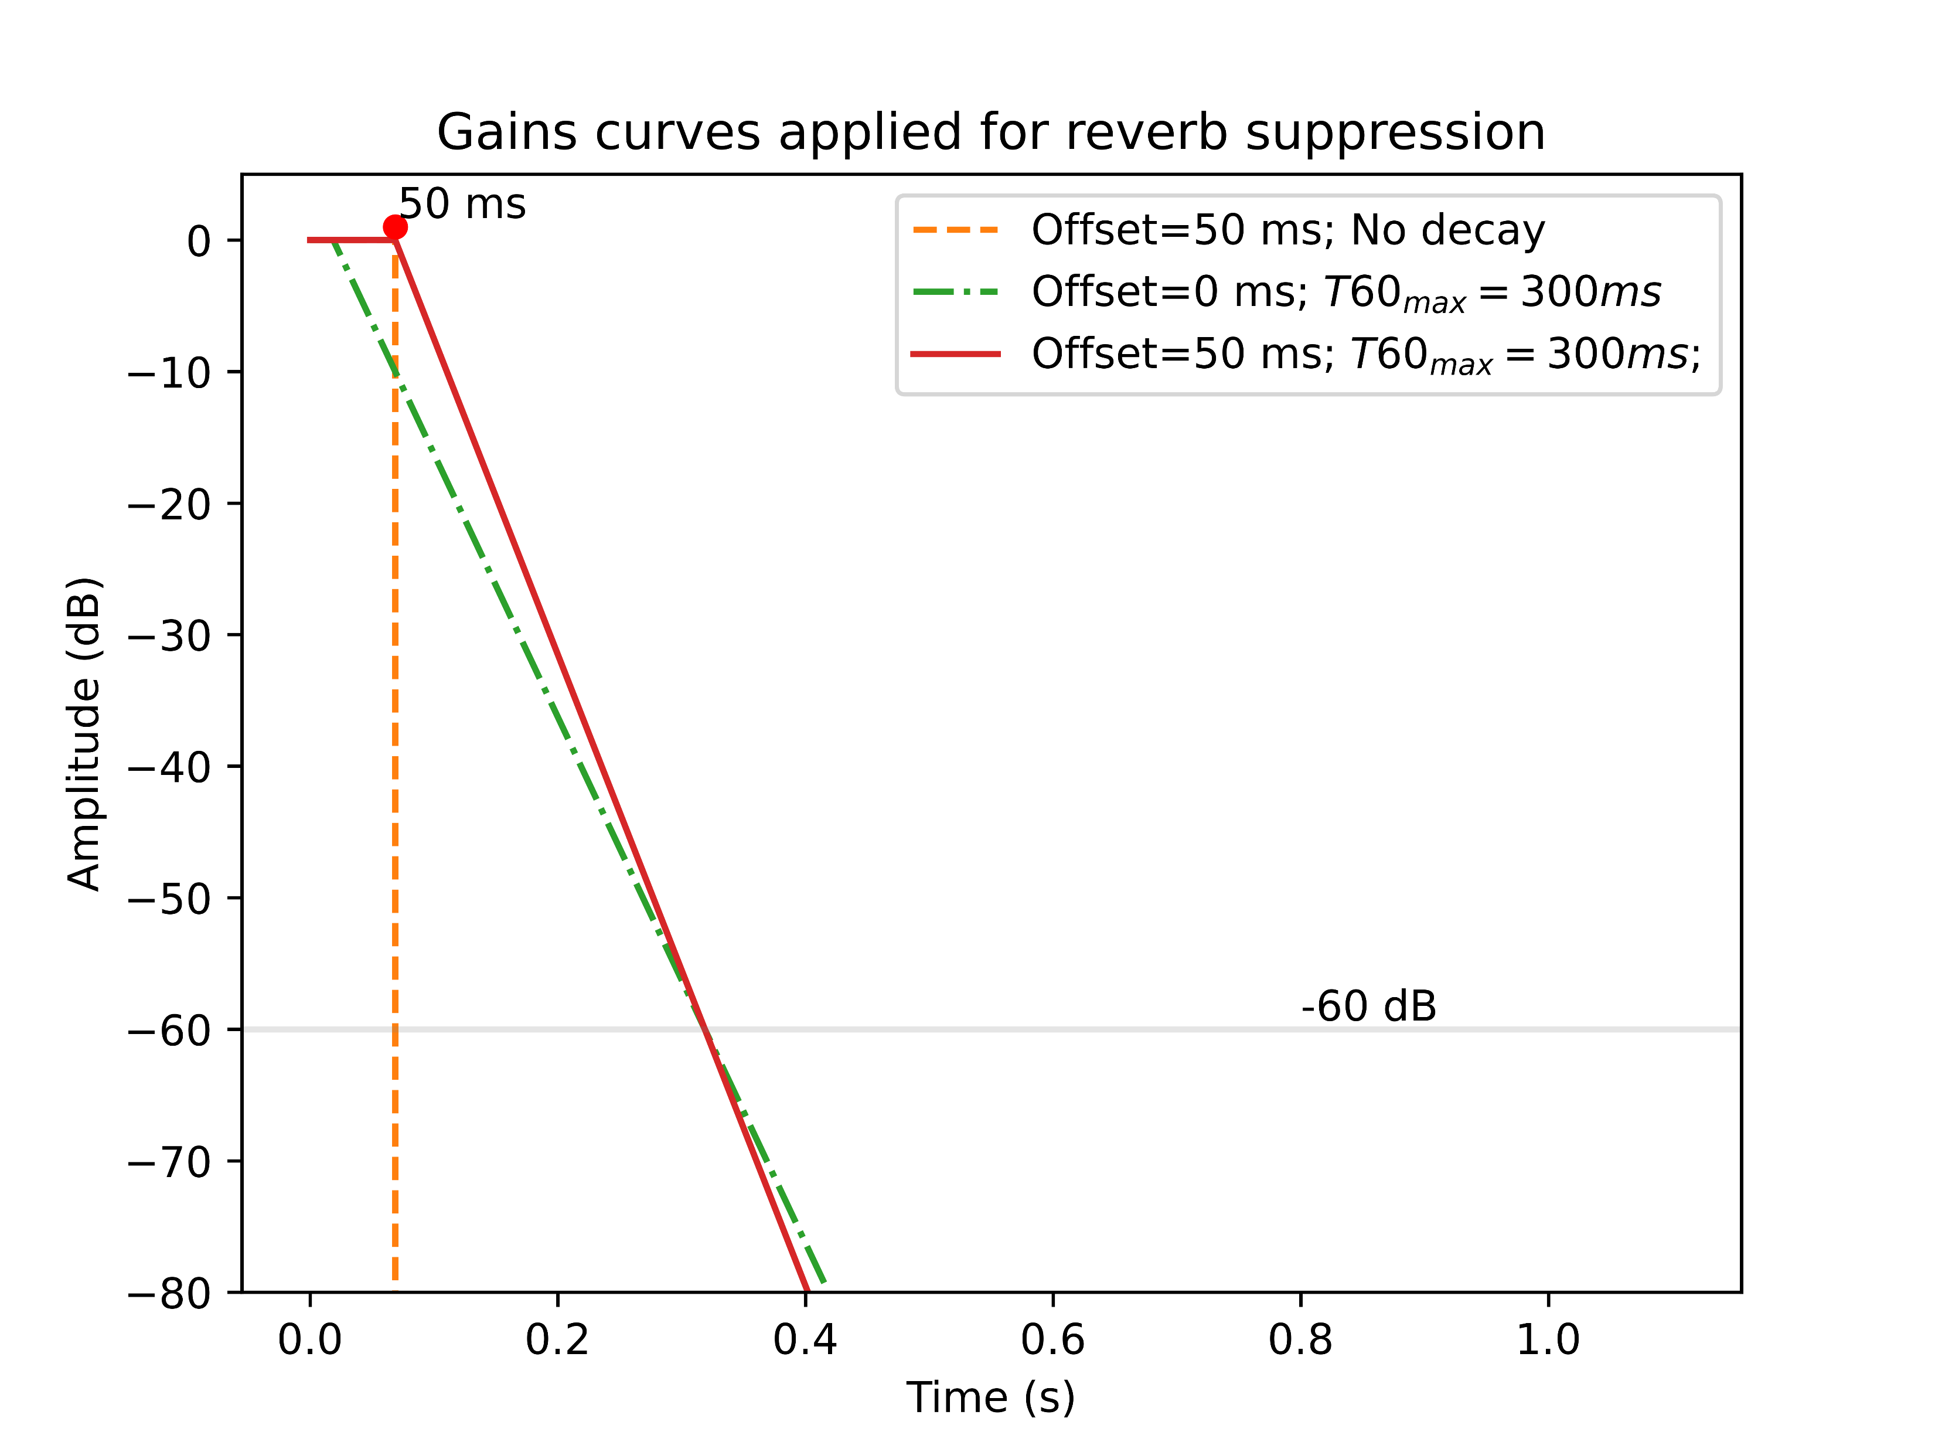
Parameters for dereverberation:
Offset: The initial duration for which the RIR is left untouched.
T60_{max}: The time at which the reverb shaping window reaches -60 dB.

Slide 3

Female voice, T60=1.0 s, distance ~ 10 meters)
Recording
(0, N.D.)
(5, N.D.)
(30, N.D.)
(50, N.D.)
(80, N.D.)
(0, 150)
(5, 150)
(30, 150)
(50, 150)
(80, 150)
(0, 300)
(5, 300)
(30, 300)
(50, 300)
(80, 300)
(0, 500)
(5, 500)
(30, 500)
(50, 500)
(80, 500)

Slide 4
Male voice, T60=1.0 s, distance ~ 10 meters)
Recording
(0, N.D.)
(5, N.D.)
(30, N.D.)
(50, N.D.)
(80, N.D.)
(0, 150)
(5, 150)
(30, 150)
(50, 150)
(80, 150)
(0, 300)
(5, 300)
(30, 300)
(50, 300)
(80, 300)
(0, 500)
(5, 500)
(30, 500)
(50, 500)
(80, 500)

Slide 5
Simulated with gpuRIR (~7 meters)
Recording
(0, N.D.)
(5, N.D.)
(30, N.D.)
(50, N.D.)
(80, N.D.)
(0, 150)
(5, 150)
(30, 150)
(50, 150)
(80, 150)
(0, 300)
(5, 300)
(30, 300)
(50, 300)
(80, 300)
(0, 500)
(5, 500)
(30, 500)
(50, 500)
(80, 500)

Slide 6
Simulated with gpuRIR (~4 meters)
Recording
(0, N.D.)
(5, N.D.)
(30, N.D.)
(50, N.D.)
(80, N.D.)
(0, 150)
(5, 150)
(30, 150)
(50, 150)
(80, 150)
(0, 300)
(5, 300)
(30, 300)
(50, 300)
(80, 300)
(0, 500)
(5, 500)
(30, 500)
(50, 500)
(80, 500)

